Slide 2
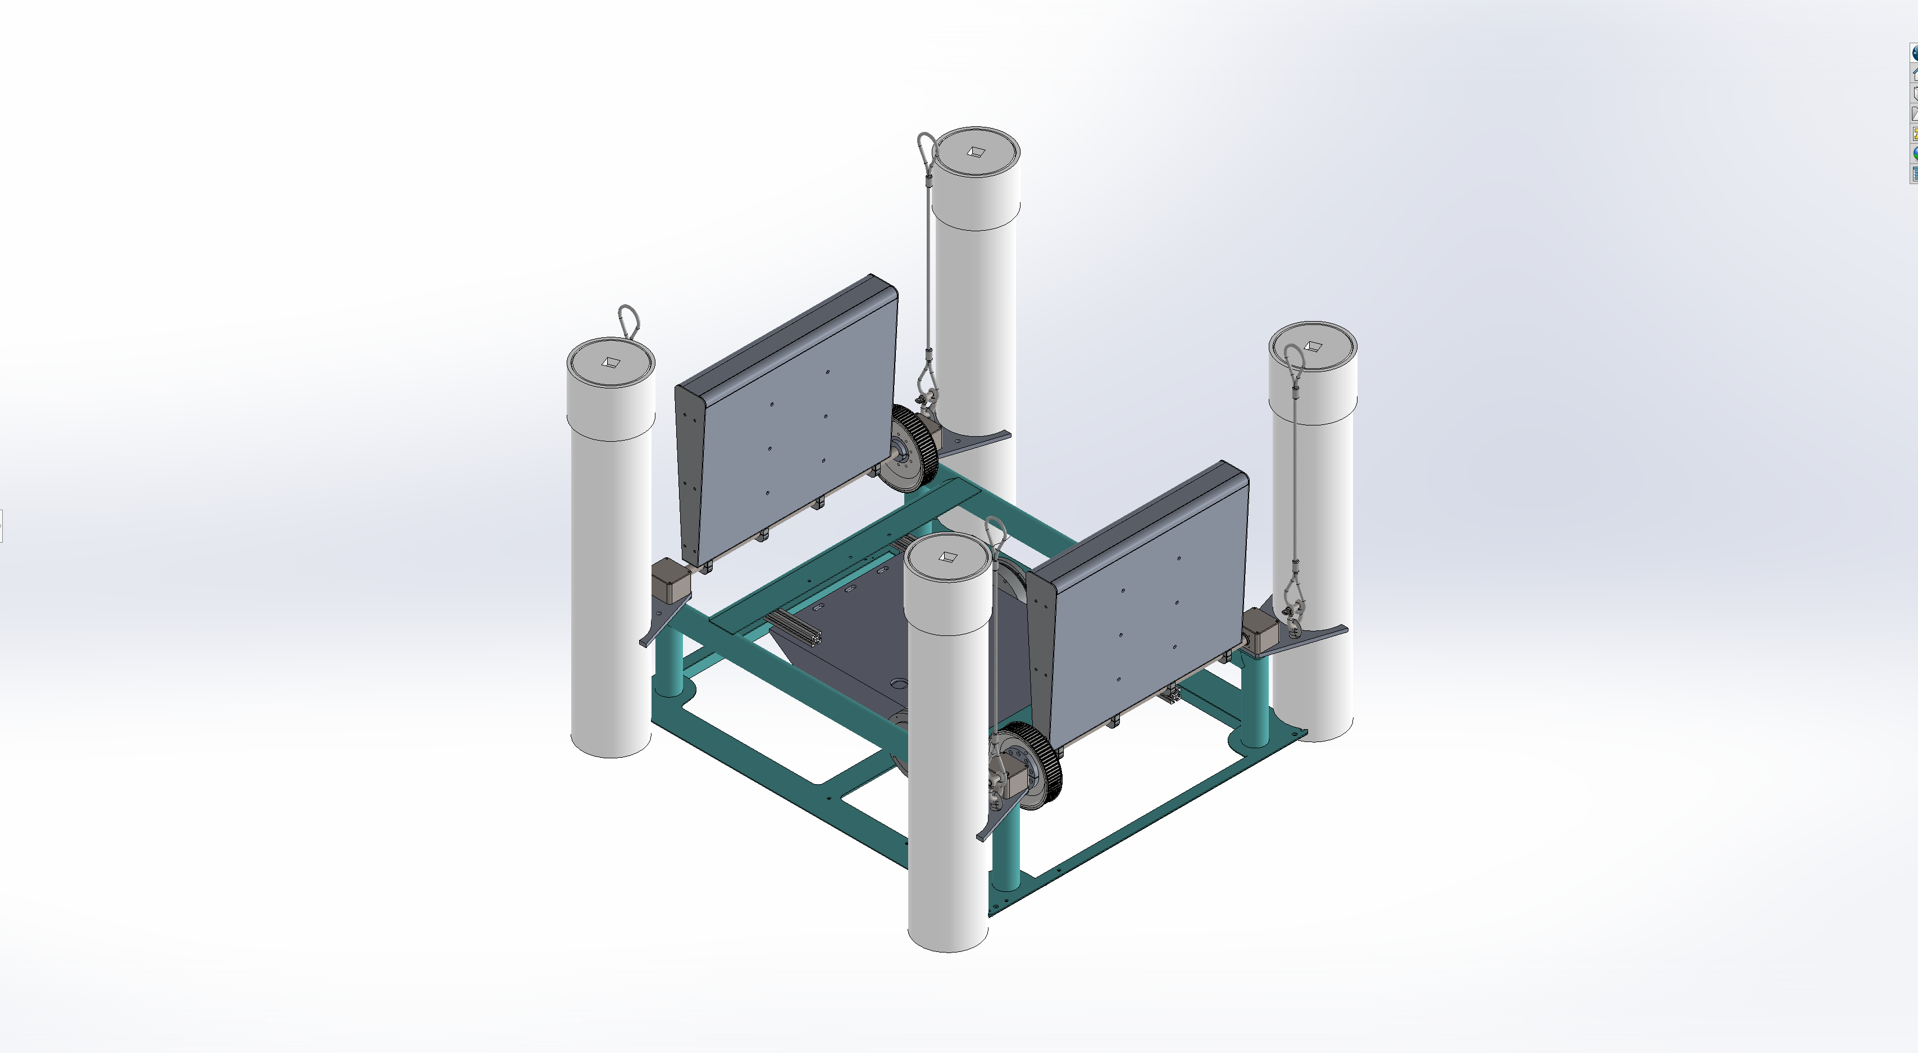
Incident wave direction
Bow
Starboard
Aft
Z
Y
Port
X

Slide 3
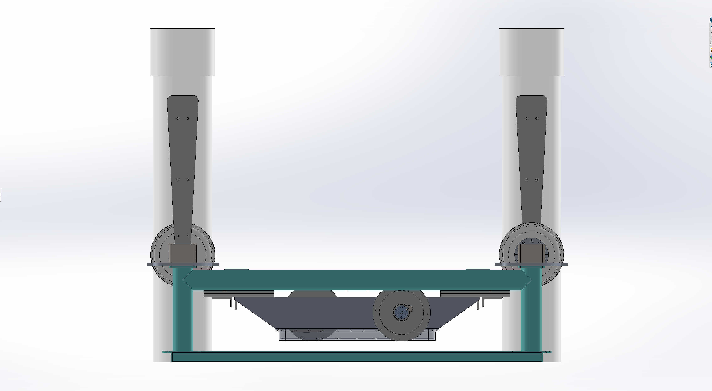
Bow
Aft
Z
X

